Slide 1

CST1302 Foundation of Web Programming – Lecture 4
A. A. Datti

Slide 2
Course Outline
Introduction to World Wide Web
Basic HTML
TEXT
Heading
Paragraphs
Line Break
Block quote
Bold
Emphasis
Italics
Mark
Small
Strong
Superscript & Subscript
Lists
Special Characters
Div
OBJECTS
Horizontal Rule
Links
Image
Audio
Video
Tables
Forms
Cascading Style Sheet

Slide 3
HTML Table
Tables are used on web pages to organize information in tabular form
Composed of rows and columns – similar to a spreadsheet.
Each individual table cell is at the intersection of a specific row and column.
Configured with table, tr, and td elements

Slide 4
Example
Each table begins with a <table> tag and ends with a </table> tag.
An optional <caption></caption> tag can be used to specify the caption of the table
Each table row begins with a <tr> tag and ends with a </tr> tag. A header row begins with <th> tag and ends with a </th>
Each cell (table data) begins with a <td> tag and ends with a </td> tag.
The <td> elements are the data containers of the table. They can contain all sorts of HTML elements; text, images, lists, other tables, etc.

Slide 5
HTML Table Example
Basic Table
<table> <caption>Web Design in BUK</caption>
<tr>
<th>Course Code</th>
<th>Course Name</th>
</tr>
<tr>
<td>CST1302</td>
<td>Foundations of Web Programming</td>
</tr>
<tr>
<td>CSC2233</td>
<td>Advanced Web Programming</td>
</tr>
</table>

Slide 6
HTML Table Example 2
Using border, cellspacing, cellpadding attribute
<table border=1 cellspacing=“10” cellpadding=“0”> <caption>Web Design in BUK</caption>
<tr>
<th>Course Code</th>
<th>Course Name</th>
</tr>
<tr>
<td>CST1302</td>
<td>Foundations of Web Programming</td>
</tr>
<tr>
<td>CSC2233</td>
<td>Advanced Web Programming</td>
</tr>
</table>

Slide 7
Common HTML Attributes
align:
horizontal alignment of table or cell contents (use withn <br/>)
valign
Aligns row or cell contents vertically (top, middle or bottom)
bgcolor:
Background color of table, row or cell
colspan
Merge cells horizontally
rowspan
Merge cells vertically
height :
Specifies the height of the table or row in pixels or percentage
width :
Specifies the width of the table or row in pixels or percentage
CSS is better in configuring most table cells instead of HTML attributes

Slide 8
HTML colspan and rowspan Attributes
Table cells have two important attributes:
Colspan: defines how many columns the cell occupies
Rowspan: defines how many rows the cell occupies
<table border="1">
<tr>
<td colspan=“2”> Birthday List</td>
</tr>
<tr>
<td>Aisha</td>
<td>11/08</td>
</tr>
<tr>
<td>Adam</td>
<td>4/17</td>
</tr>
</table>

Slide 9
HTML rowspan Attribute
<table border="1">
<tr>
<td rowspan="2">This spans two rows</td>
<td>Row 1 Column 2</td>
</tr>
<tr>
<td>Row 2 Column 2</td>
</tr>
</table>

Slide 10
Nested Tables
Table data “cells” (<td>) can contain nested tables (tables within tables):
<table> <tr> <td>Contact:</td> <td> <table> <tr> <td>First Name</td> <td>Last Name</td> </tr> </table> </td> </tr> </table>

Slide 11
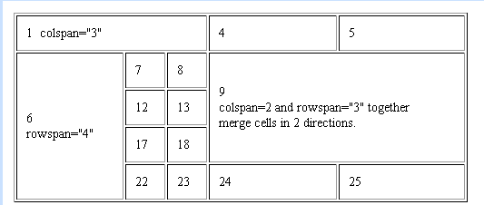
…..
Demonstrating rowspan and colspan attributes

Slide 12
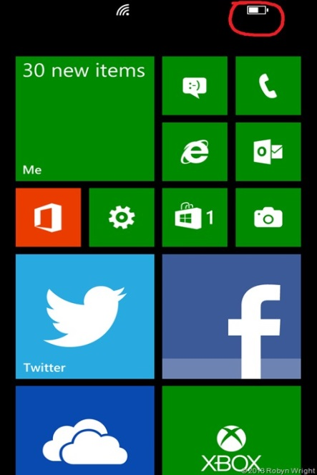
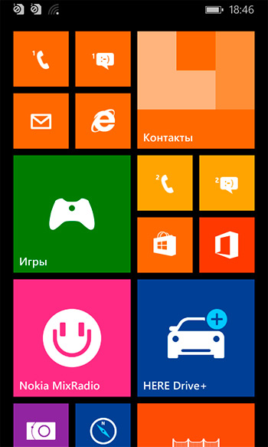
Assignment
Personalized Lecture Timetable
Must contain at least one animated image or a short movie (muted autoplay and loop)

